Slide 1
Technology Committee Update
December 2025
Copyright ©2025 Howard Hughes Holdings Inc.

Slide 2
HHX Mission Refresher
TECHNOLOGY COMMITTEE UPDATE
Our efforts are aligned to achieve three strategic business goals:
Cutting Overhead
Implementing tools that make us faster, more self-sufficient, and accurate —reducing clerical work, manual processes, and administrative costs over time.
Supporting Revenue
Beginning with leasing, we are using AI and emerging technology to shorten negotiation-to-execution timelines and accelerate cash collection.
Training Our Workforce
We are creating a culture of curiosity and AI literacy—empowering our teams to unlock improvements in every corner of the business on their own.
The Innovation Hub at Howard Hughes
2

Slide 3
2025 In Review
TECHNOLOGY COMMITTEE UPDATE
This year HHX shifted from experimentation to execution at scale. We moved AI from concept to habit, innovation became an organization-wide capability, and we grew our partner ecosystem.
Select Highlights
Company-Wide AI
We embedded AI into the daily rhythm of work
Finalized AdaOS 1.0
Built the foundation for our automated back-office
Reskilled Workforce
Delivered robust training and change management
Holistic Innovation
Not everything we do is about AI
Rolled out Glean to the entire company, drove AI adoption to 54%+ with 47,500+ searches/chats. Supported creation of high‑value AI agents in Legal, Internal Audit, and Accounting that are embedded in daily work with measurable gains.
Automated lease drafting and abstraction set to go live in Q1 2026 positions HHC for an estimated $1M+ cost reduction, 2,000+ labor hours avoided, and 99% faster processing. Lays backbone for further back‑office automation across workflows in 2026.
Company‑wide AI training grew to 60%+ participation, with 4,000+ training videos and 600+ courses completed, reinforced by our Innovation Leads program. The HHX Innovation Summit aligned stakeholders on priorities, turning enablement into durable operating habits.
Our AV&C joint venture is positioned for revenue. The JV initially secured our Digital Sales Gallery IP. Now we have expanded the platform into new business lines (e.g., multifamily, lot sales) and opened a commercialization pipeline for new revenue.
The Innovation Hub at Howard Hughes
3

Slide 4
Q4 2025 Highlights
TECHNOLOGY COMMITTEE UPDATE
This quarter was all about building habits – training and reskilling, advancing AI adoption, and preparing HHX for scale.
Signals of Transformation
Metrics that show we are deepening AI fluency and adopting new ways of working organization-wide.
Some highlights from this quarter include:
Expanded AI fluency across the company – 60%+ of the company active in AI Academy, completing 600+ courses and logging 4000+ videos of training.
Embedded AI into daily workflows – AI adoption (Glean) is now over 54% of the company monthly, 36% weekly, and 16% daily.
Hosted our second annual Innovation Summit – Over 80 people joined us in The Woodlands, with representation from every region and function.
Advanced core initiatives – Continued steady progress on foundational projects like AdaOS and the Financial Command Center (FinCommand).
70%
Adoption
Share of monthly Glean users that are returning weekly
500+
Hours
Weekly time saved with AI, as reported by employees
$150K
Savings
Eliminated an entire function by deploying a single AI tool
The Innovation Hub at Howard Hughes
4

Slide 5
Maturing HHX
TECHNOLOGY COMMITTEE UPDATE
For Discussion: How should we balance breadth versus depth in our innovation agenda—prioritizing functional diversity across the business versus doubling down on high-impact verticals?
We are maturing our innovation platform to meet the evolving needs of HHH.
Where We Are Headed
Expanding to new domains – Unlocking value in areas like procurement, financial reporting, and due diligence.
Building enterprise innovation muscle – Investing deeper in training, reskilling, Innovation Leads, and other programs designed to embed and incentivize innovation behavior across the organization.
Creating value from intellectual property – monetizing our efforts through design partnerships, warrants, revenue-shares, and co-development arrangements.
On The Horizon for 1H 2026
Launching AdaOS 1.0
Our platform to automate lease operations is set to go live in Q1; with expansion planned into adjacent areas such as contract redlining, straight-line rent and common area maintenance (CAM) calculation.
Collaborative Wins
HHX-sourced and Business Unit led initiatives to unlock efficiencies in areas like automated accounts payable (Open Envoy) and contract auditing (AuditMate).
Monetizing Innovation
Growing revenue through our AV&C joint venture and exploring platform plays with Tenant Portal and AdaOS.
The Innovation Hub at Howard Hughes
5

Slide 6
Resourcing and Operating Model
TECHNOLOGY COMMITTEE UPDATE
For Discussion: What balance should we strike between core team growth and flexible capacity as demand for innovation grows across the HHH portfolio?
We are fine-tuning a flexible operating model to scale fast without inflating fixed costs.
Key Features:
Blending full-time equivalents, flexible contractors, and strategic partners to match demand and speed without expanding fixed-cost base.
Expanding bandwidth in key skillsets – product and program management, process redesign/integrations, data science, software/AI engineering, and change management.
Maintaining discipline through strong governance and tight cross-functional collaboration that safeguards quality, security, and delivery as demand increases.
Modular Team Structure
Strategic Partners
Flexible Contractors
Full-Time Equivalents
The Innovation Hub at Howard Hughes
6

Slide 7
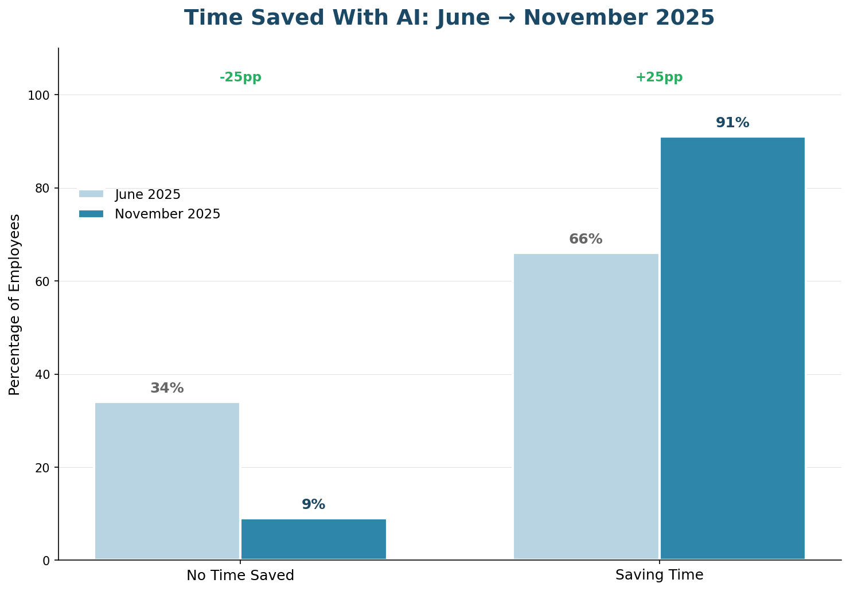
Workforce AI Adoption – Embedding AI in Everyday Work
TECHNOLOGY COMMITTEE UPDATE
For Discussion: How do we best identify and reward people who deliver measurable AI value, balancing recognition, incentives, and accountability?
AI adoption is translating into measurable gains in productivity, collaboration, and how people get work done across the company.
AI Efficiency Gains
Key Takeaways from November AI Survey
86% of respondents are using AI weekly, as compared to 49% in June.
83% of respondents would be disappointed if they could no longer use AI tools, compared to 69% in June.
70% of the company are active in Glean, indicating strong awareness and adoption.
70% of monthly Glean users are returning weekly, showing usage is becoming a habit, not just a novelty.
91% report they are now saving 1-5+ hours weekly with AI tools, 16% are saving 4-12+ hours.
The Innovation Hub at Howard Hughes
7

Slide 8
Workforce Training – Becoming an AI-Proficient Organization
TECHNOLOGY COMMITTEE UPDATE
For Discussion: How should we evolve our AI training, so it stays relevant and engaging at scale and never feels repetitive or stale?
Strong engagement in training and education validates our approach.
Moving From Awareness to Habit-Building
Our focus is shifting from AI literacy and exposure to tools to driving behavior change and consistent habits that improve the quality of day-to-day work and drive measurable value. Tactics include:
Role and function-based skills sessions
Hackathon labs and use case spotlights
Incentives for knowledge sharing and creation of agents and automations
Feedback From The Company
“The HHX team is a great partner and sharer of information and new resources. Just keep doing what you're doing!”
David Zolno, Legal
“The company wide roll out and integration with accessible classes and live meetings has been awesome.”
Kyle Michibata, Leasing
Activating the Q3 2025 Workforce Study
In partnership with the new head of HR, we will be launching a segmentation and upskilling strategy in 2026 to provide training pathways by role, readiness, and opportunity - as shared at last quarter’s meeting.
The Innovation Hub at Howard Hughes
8

Slide 9
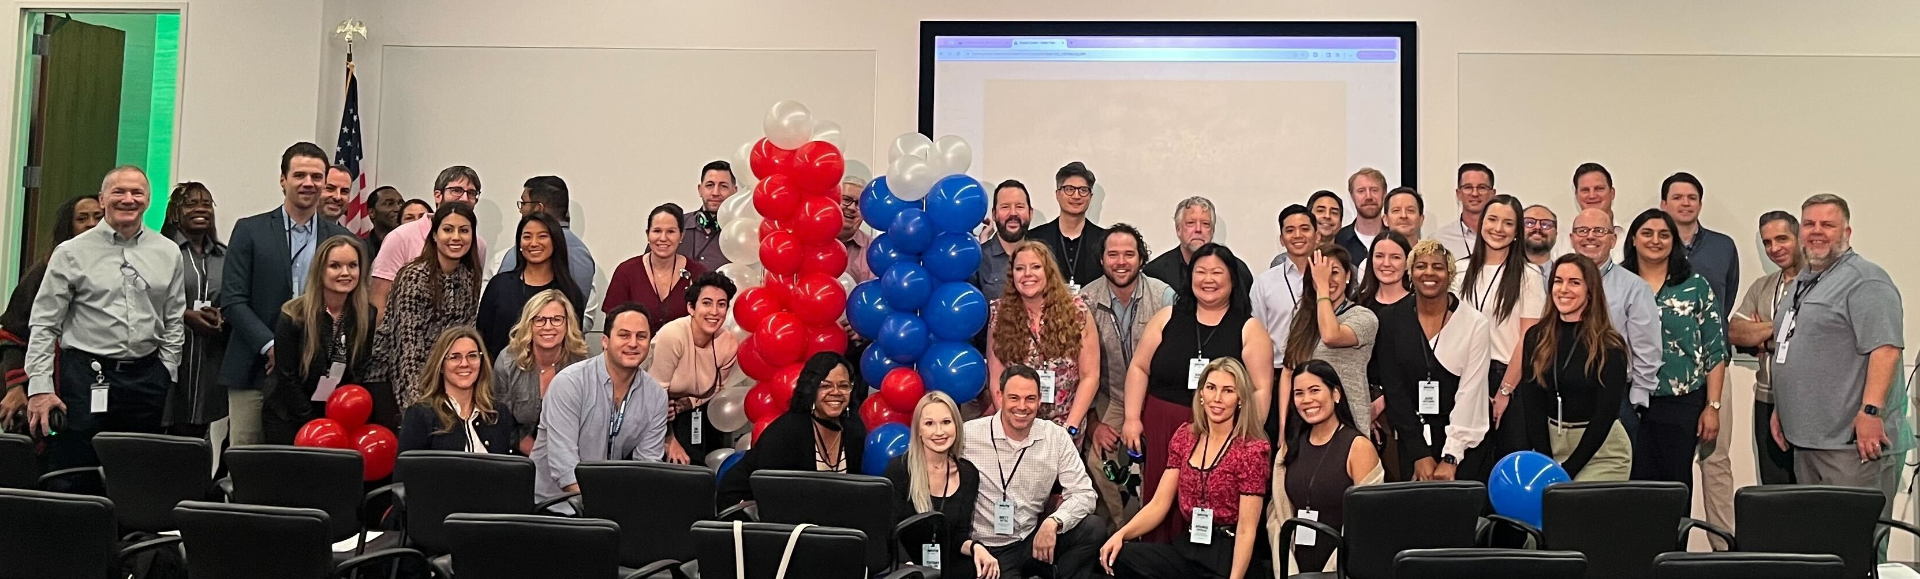
Inspiring Innovation – 2025 HHX Innovation Summit
TECHNOLOGY COMMITTEE UPDATE
For Discussion: How do we translate the Summit’s ideas and inspiration into year-long
action and continuous momentum?
The Innovation Summit is our annual flagship event to align teams, accelerate execution, and spark new ideas—reaching employees via in-person sessions and company-wide livestream.
2025 HHX Innovation Summit
Key Takeaways
Keynote from Dror Poleg crystallized the “why now,” connecting AI, real estate, and placemaking to HHC’s strategy.
Enterprise AI enablement is taking root, with employee-built agents and Glean use cases starting to scale across teams.
AdaOS demos showcased real ROI potential—moving from conceptual to automation across leasing processing.
ProptechOS revealed the future of building operations, with digital twins and the ability to chat with building data via AI agents.
By the Numbers
A day and a half packed with breakthrough ideas and collaborative innovation challenges
80+ attendees, representing all regions and functions
66% first-timers, 34% returning from last year
Livestreamed keynote to entire company
The Innovation Hub at Howard Hughes
9

